Slide 1
Montana Bioscience Cluster Initiative

Slide 2
Webinar Agenda
Overview of Montana’s Bioscience Sector
Industry Workforce Needs
Educational Initiatives
Future Opportunities
Industry Partner Perspective: Dr. Karen Brown, KLEO Research
Q&A

Slide 3
Defining the Bioscience Industry

Slide 4
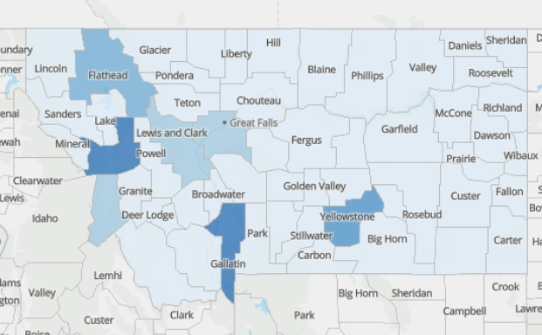
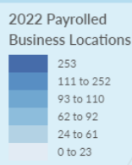
Where is bioscience in MT?
Lightcast Q4 2023 Data Set

Slide 5
1. Continued Rapid Growth & Hiring in Bioscience

Slide 6
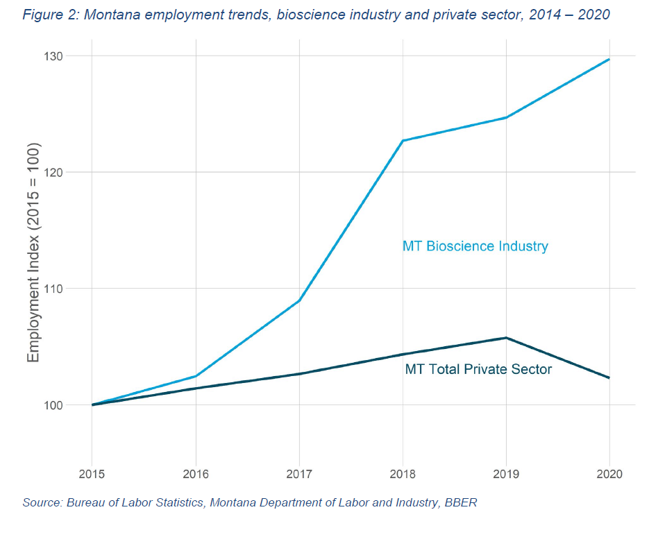
Montana Bioscience Cluster Initiative

Slide 7
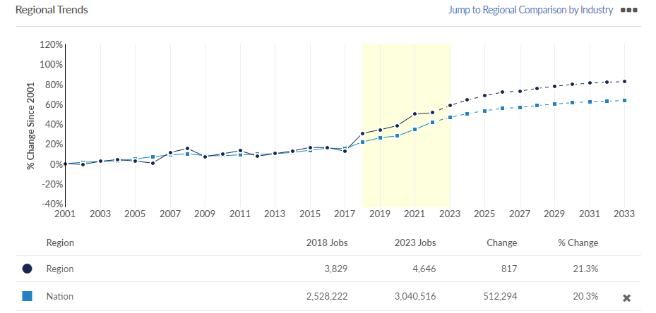
Lightcast Q4 2023 Data Set

Slide 8
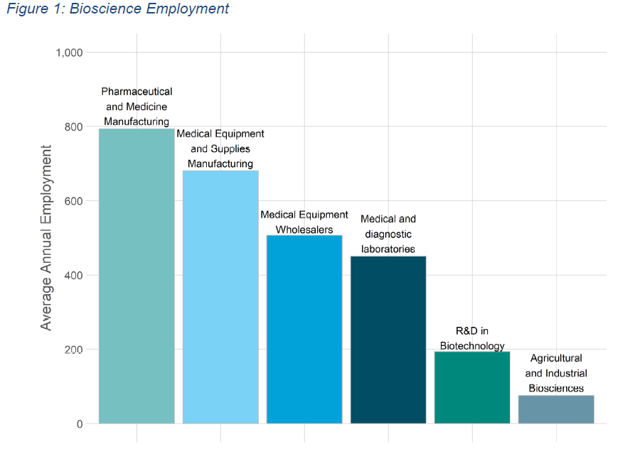
Montana Bioscience Cluster Initiative

Slide 9
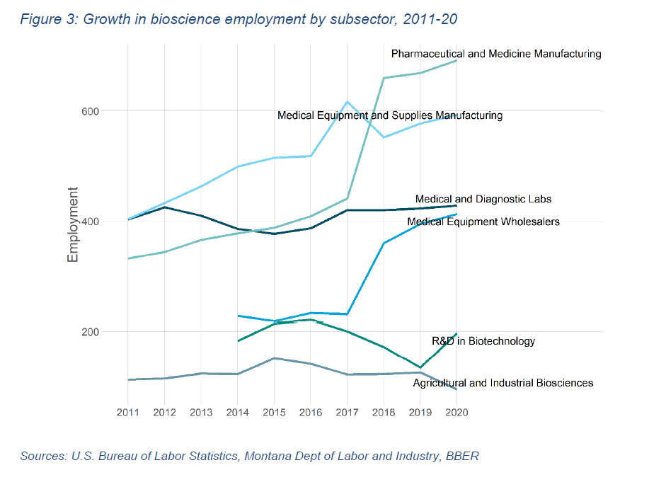
Montana Bioscience Cluster Initiative

Slide 10
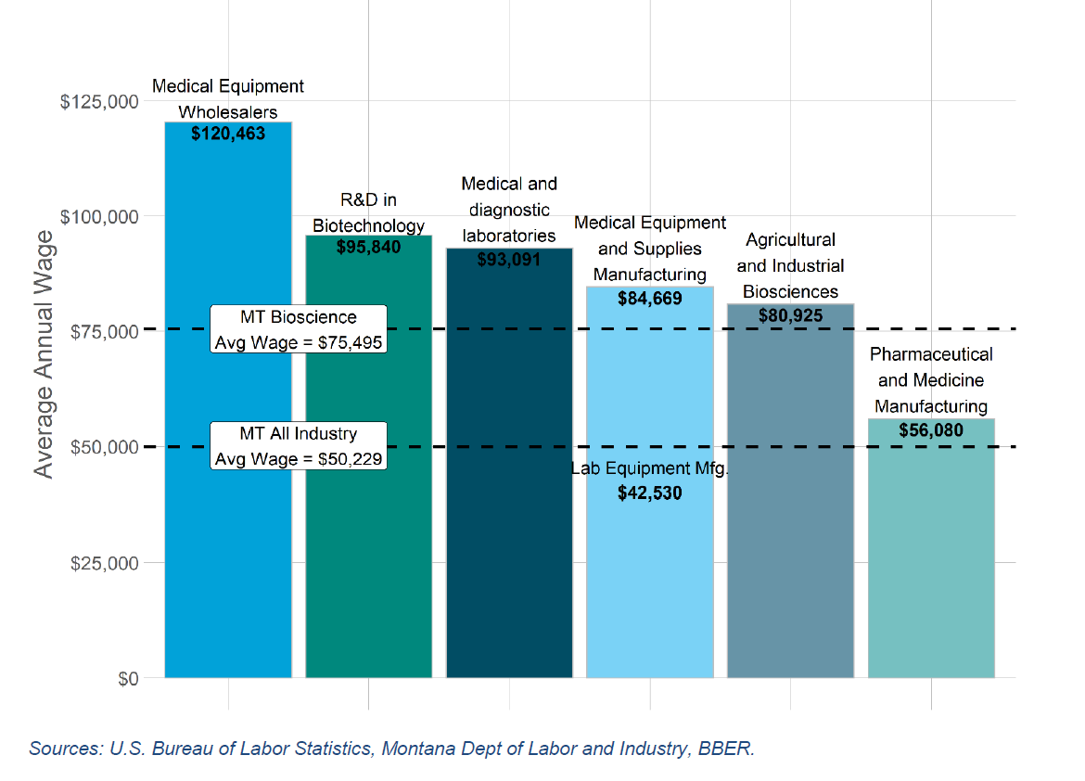

Slide 11
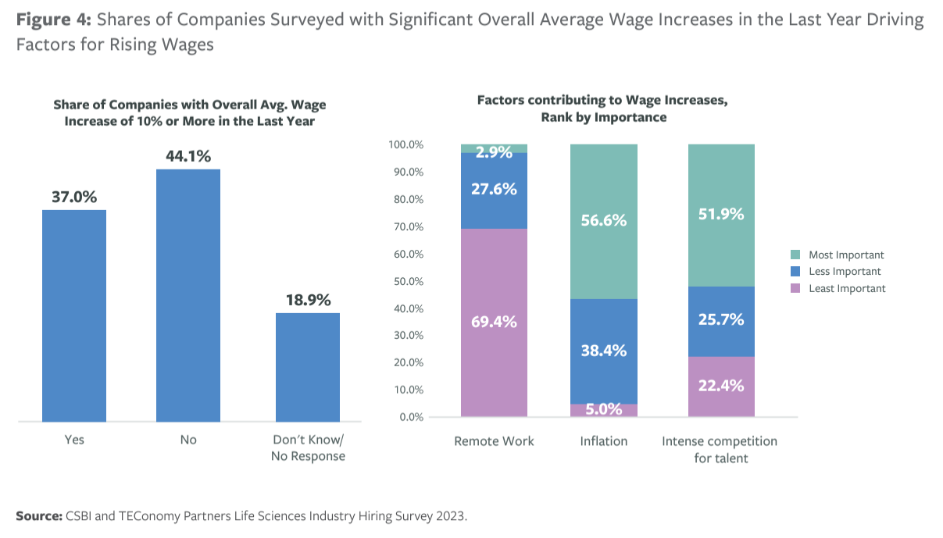

Slide 12
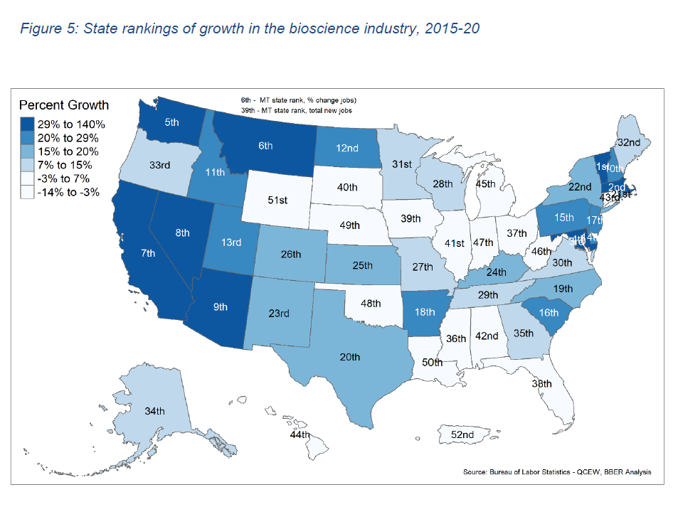
Montana Bioscience Cluster Initiative

Slide 13
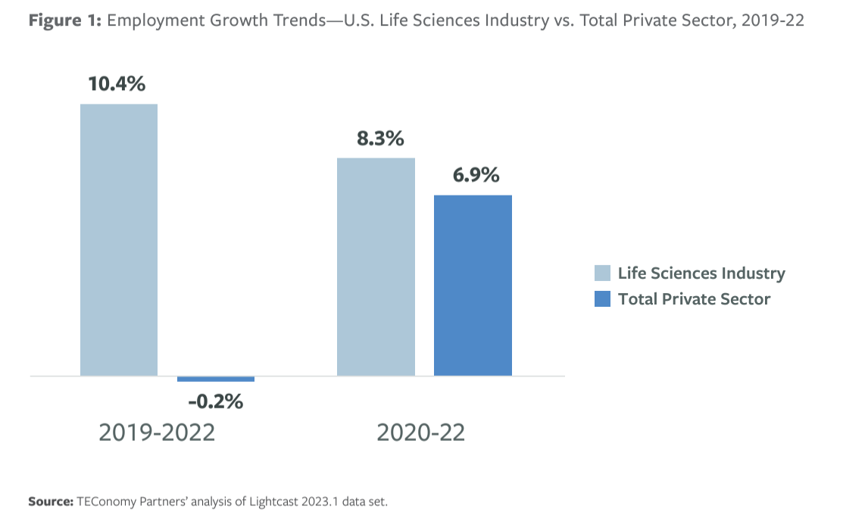

Slide 14
2. Steady Need for Skilled Workforce—all types of skills

Slide 15
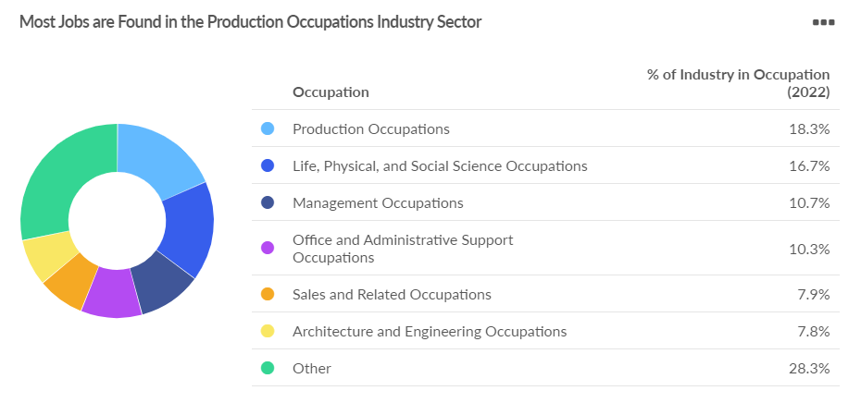
Lightcast Q4 2023 Data Set

Slide 16
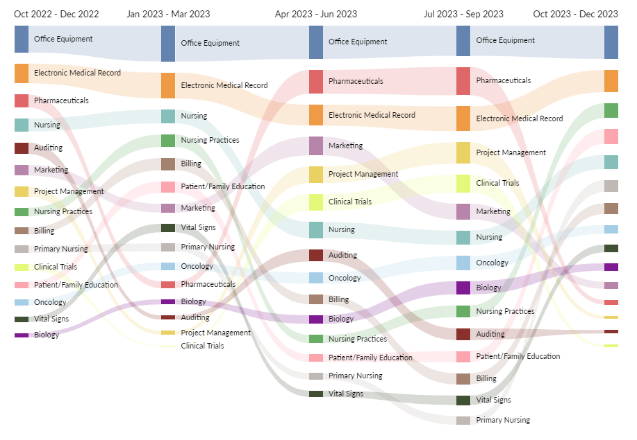
Lightcast Q4 2023 Data Set

Slide 17
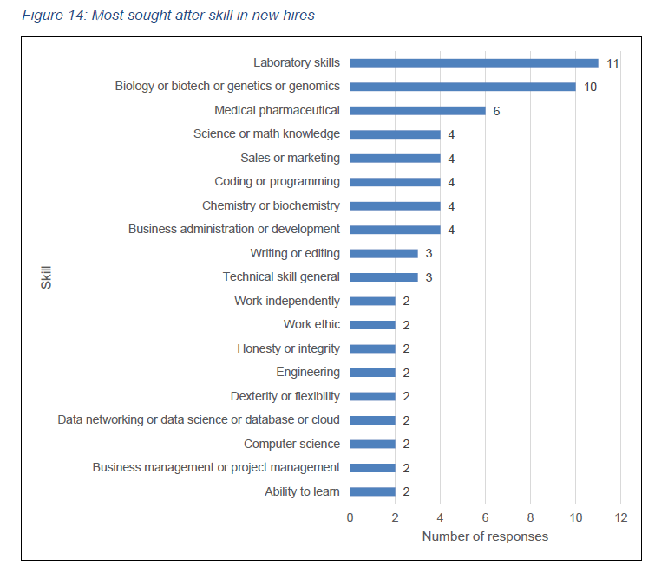
Source: BBER Survey of Bioscience Firms, 2022

Slide 18
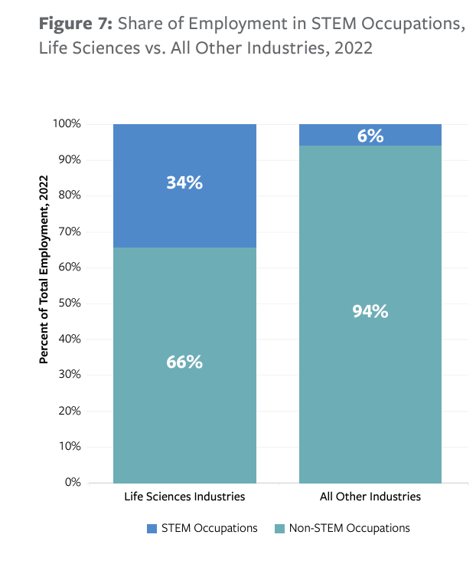

Slide 19
3. Academic-Industry Partnerships are more important than ever

Slide 20
Educational Initiatives
Biotechnician Assistant Credential Exam (BACE)
STEM Career Pathways Awareness

Slide 21
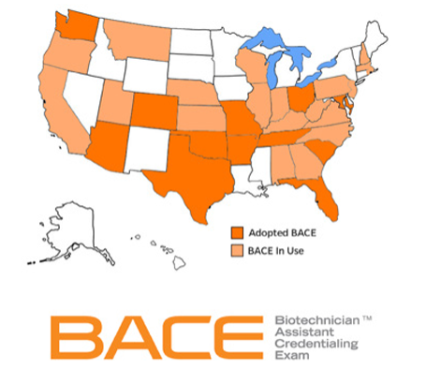
The BACE is a national industry-recognized exam that assesses core competencies and skills identified as valuable to the bioscience industries.
About the BACE
Notes:
The BACE is an industry recognized credential that was launched in 2012. This year we are celebrating our 10anniversary, as well as passing the milestone of having over 10,000 candidates sit for the exam. We began work to develop the BACE in 2010, when Florida passed legistlation requiring students in our technical programs have the opportunity to earn an industry recognized credential. This coincided with the US DOE (OVAE) program of study initiative, to re-define vocational education into CTE. They funded us under a rigorous program of study grant to develop the BACE.

Slide 22
BACE Parameters
Test Specifications:
Scope:
The BACE assesses a candidate’s mastery of knowledge and skill sets valued by the industry for technician-level positions. Credential earners possess the ability to seamlessly enter the workplace to be quickly trained on company-specific protocols relating to research and development, quality systems, biomanufacturing, and a variety of other positions within the industry. Additionally, they have demonstrated an aptitude for the work, and knowledge of working in a cGMP compliant environment.
BACE Knowledge Exam
Format: | Closed Book
Exam Duration: | 1.5 Hours
Category | Questions | Points
General Topics in Biotechnology | 33 | 26.5
Technical Skills/Applications | 52 | 36
Biochemistry/Chemistry | 17 | 13
Biological Systems | 13 | 12
Workplace Safety & Behavior | 16 | 12.5
Total | 131 | 100
BACE Practical Exam
Format: | Closed Book
Exam Duration: | 2.5 Hours
Category | Questions | Points
Biotechnology Skills | 30 | 46.5
Applied Mathematics | 15 | 25
Laboratory Equipment | 16 | 14
Research & Scientific Method | 16 | 14.5
Total | 77 | 100
Notes:
As I have mentioned our exam parameters were created with significant input from both academia and industry. It is critical that once you have identified the credential that needs to be created and who you are creating it for, you document the parameters and verify the final exam parameters’ are of value to your stakeholders. Additionally, once the parameters are finalized they will become the foundation for your test development procedures. Specific subcategories that were identified by the industry may phase in or out as your industry of focus changes and grows, but the core knowledge and skills needed by an industry should be able to hold for sometime.
(Review the slide) You will see here that the Biotechnician Assistant Credentialing Exam (BACE) consists of two exam portions, the Knowledge Exam and the Practical Exam, which cover nine core biotechnology categories.
Additional FYI………….. Test Parameters/Specifics should also document:
The purpose and intended use of an exam
Exam format
Knowledge or performance
Item types
Exam duration
Delivery mode (Paper/Pencil or Computer)
Candidate eligibility requirements
Item difficulty parameters
Scoring
Points available per Category
Weighted or Unweighted items
Cutscore
Credential
Expiration date
Renewal process

Slide 24
New Opportunities

Slide 25
New Opportunities

Slide 26
Q&A

